Slide 1
Best location to open new Chinese Restaurant in Toronto
Aibek Satbayev
03.08.2021

Slide 2
A restaurant's location is one the most important factors for its success!
Owner of the global chain of Chinese restaurants wants to open brand new restaurant in Toronto as a part of the strategic development plan in North America.
He requested our firm to propose the best Toronto neighborhood to establish a Chinese restaurant.
Neighborhoods’ total and Chinese population, income levels, crime rates and competition rates must be considered during analysis.
Neighborhoods with more than average total and Chinese population must be selected only.

Slide 3
Data acquisition and cleaning
The Toronto's crime rates data: (https://open.toronto.ca/dataset/neighbourhood-crime-rates/)
Geographical coordinates of each neighborhood: (https://www.openstreetmap.org).
The Foursquare API will be used to explore neighborhood venues in Toronto. We will check presence of Chinese restaurants in each neighborhood to check possible competition.
The Toronto's census data for its social demographic characteristics (https://bit.ly/3airrOJ). We will obtain spending power, total population and distribution of Chinese population.

Slide 4
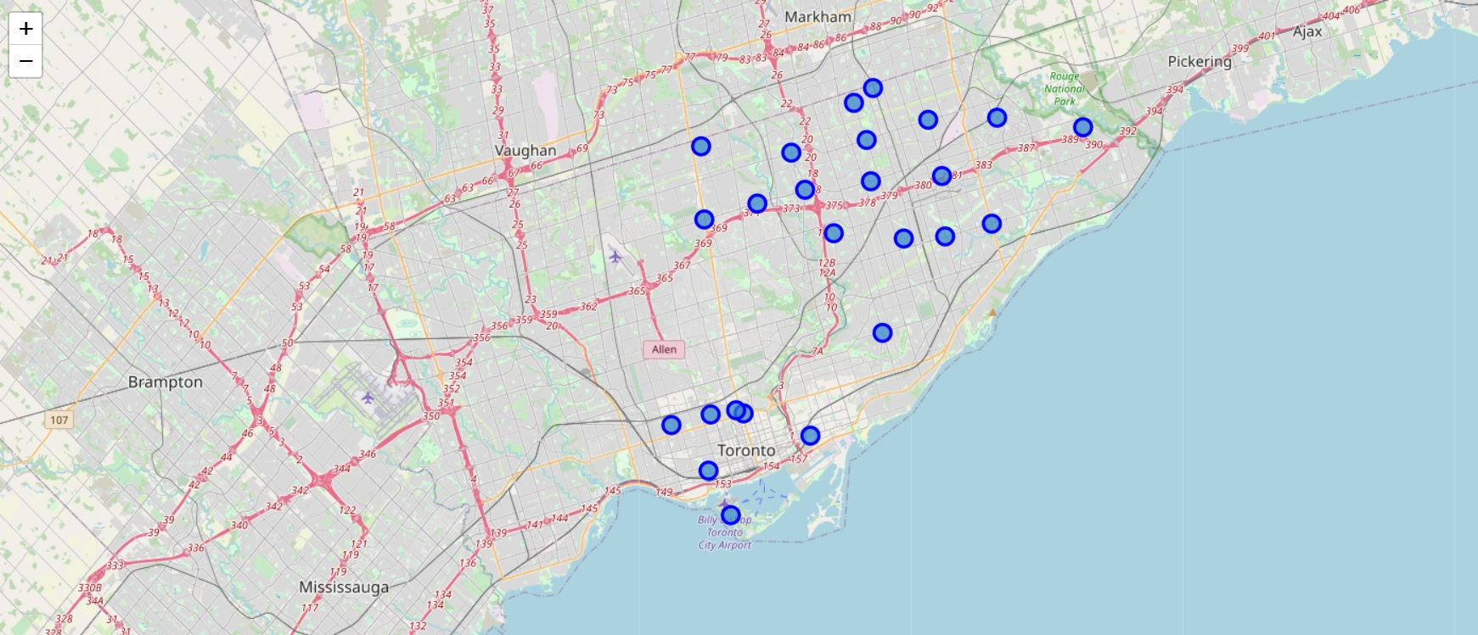
Map of 25 selected neighborhoods

Slide 5
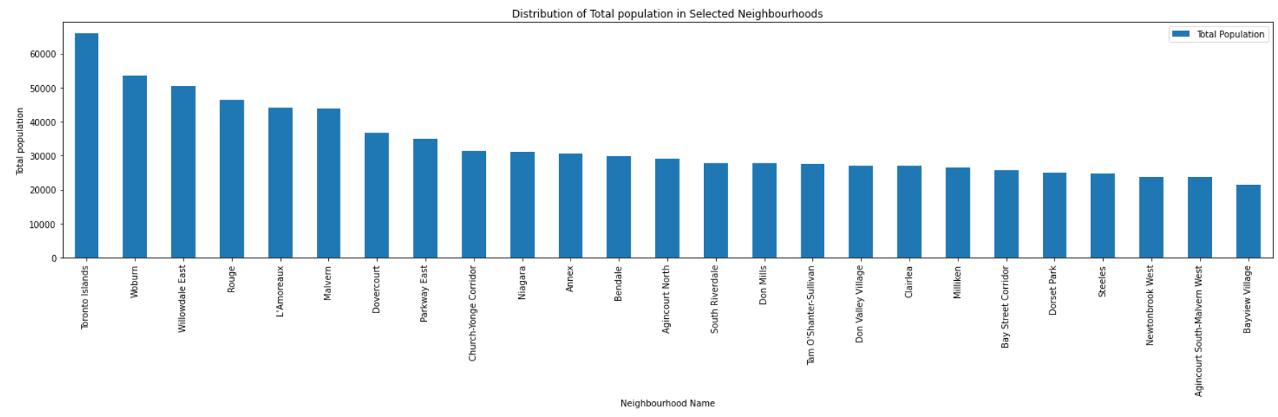
Top 6 neighborhoods by total population: ‘Toronto Islands’, ‘Woburn’, ‘Willowdale East’, ‘Rouge’, ‘L’Amoureaux’ and ‘Malvern’.

Slide 6
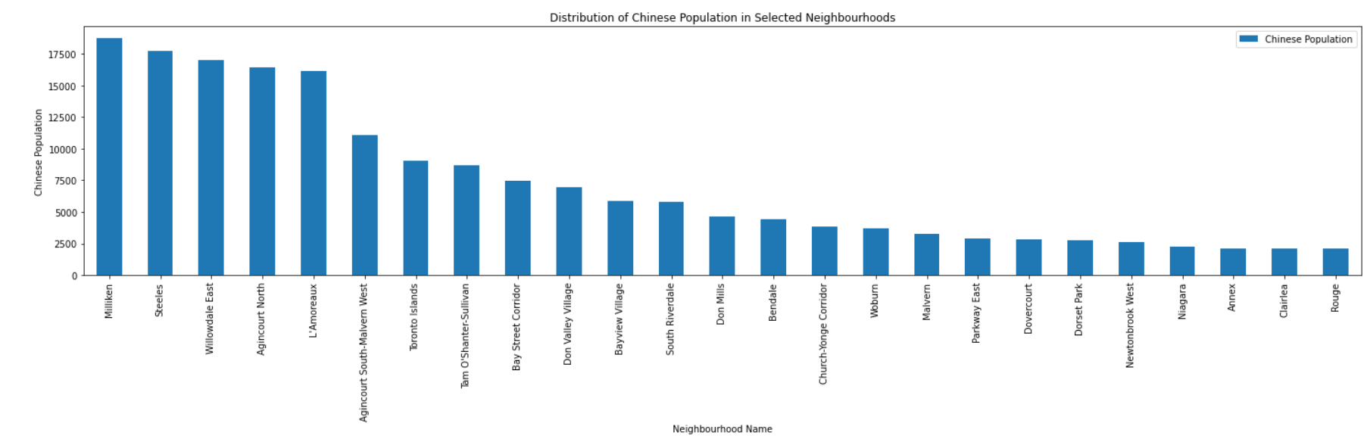
Top 5 Neighborhoods populated by Chinese: ‘Milliken’, ‘Steeles’, ‘Willowdale East’, ‘Agincourt North’ and ‘L’Amoureaux’.

Slide 7
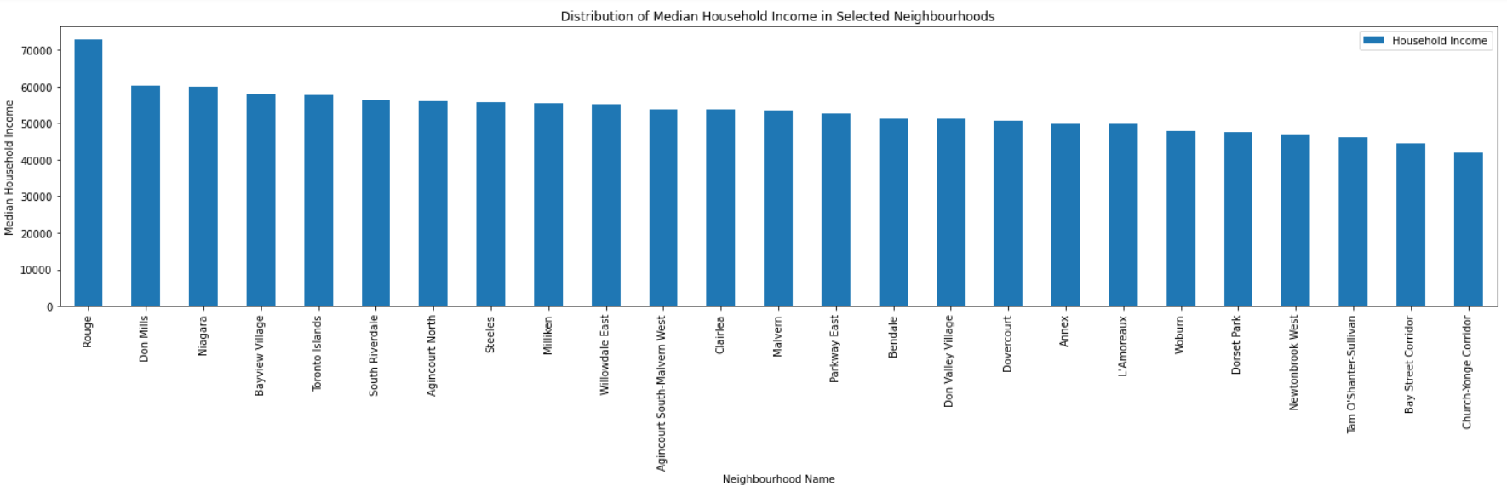
Household income is more or less equally distributed. With one exception – ‘Rouge’ had outstanding value comparing to others.

Slide 8
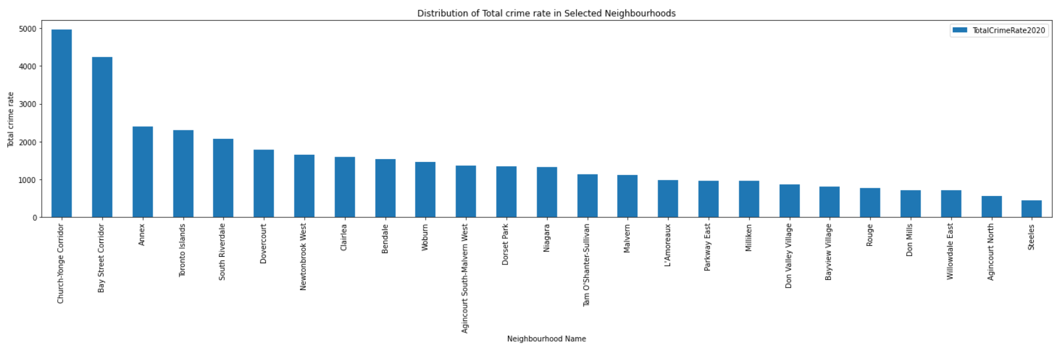
Neighborhoods with the highest crime rate are ‘Church-Yonge Corridor’ and ‘Bay Street Corridor‘.

Slide 9
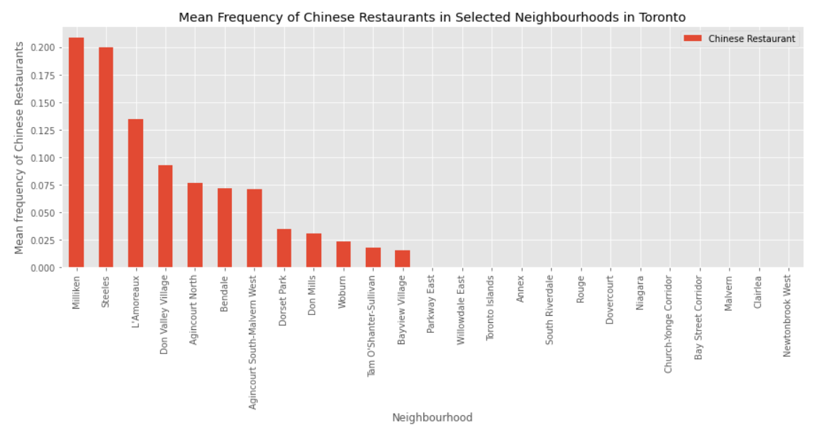
12 Neighborhoods out of 25 had Chinese restaurants. ‘Milliken’ and ‘Steeles’ neighborhoods had the most density of Chinese restaurants.

Slide 10
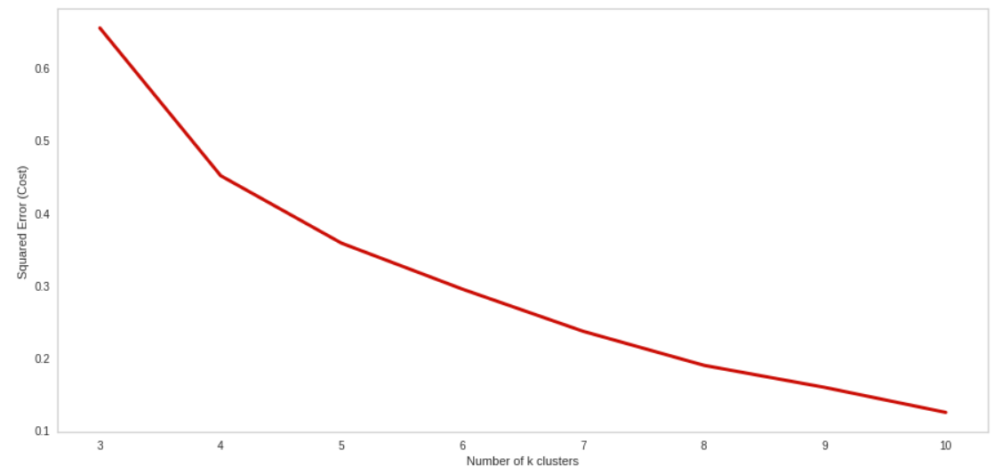
Finding the optimal number of clusters, k
So, how can we choose right value for K? The general solution is to reserve a part of your data for testing the accuracy of the model. Then chose k =3, use the training part for modeling, and calculate the accuracy of prediction using all samples in your test set. Repeat this process, increasing the k, and see which k is the best for your model.

Slide 11
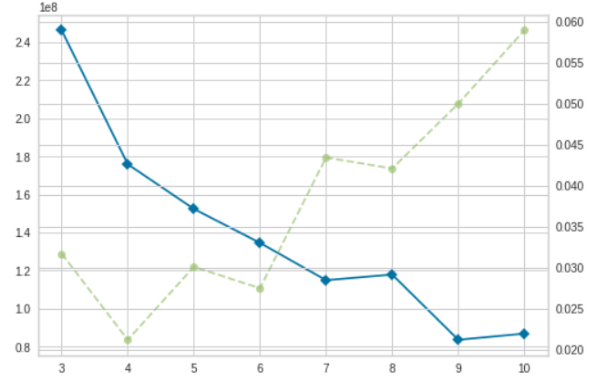
Elbow method
After analyzing using elbow method using distortion score & Squared error for each K value, looks like K = 6 is the best value.

Slide 12
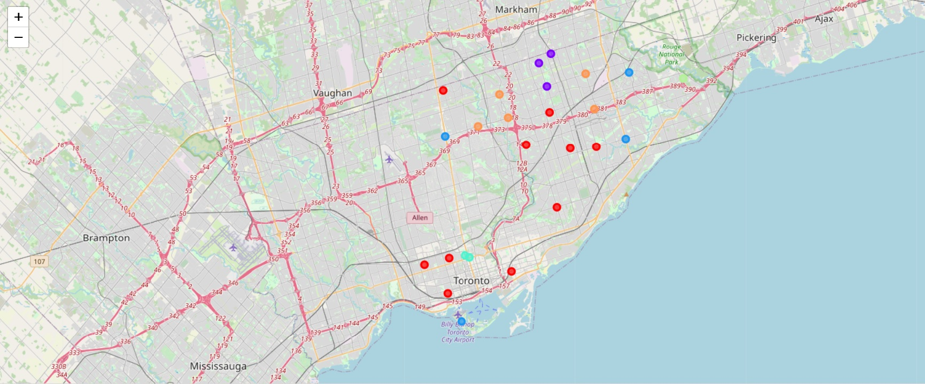
Map of neighborhoods divided to 6 clusters

Slide 13
Profiling of clusters
Cluster 0. It consists of neighborhoods with low total population and low competition rate. Not recommended.
Cluster 1. It consists of neighborhoods with high number of Chinese population and low crime rate. But competition rate is very high. Not recommended.
Cluster 2. It consists of neighborhoods with average number of Chinese population, low competition rate, and average crime rate. Recommended.
Cluster 3. It consists of neighborhoods with comparatively low household income, zero competition rate, and with high crime rate. Not recommended.
Cluster 4. It consists of neighborhoods with highest household income, average number of Chinese population, zero competition rate, and low crime rate. Recommended.
Cluster 5. It consists of neighborhoods with high competition rate and low total population. Not recommended.

Slide 14
Conclusion
'Willowdale East' from Cluster 2 is highly recommended neighborhood to open Chinese restaurant due to high number of Chinese population, low crime rate and zero competition. In addition to that it has more than average total population and household income.
Second choice is 'Rouge' from Cluster 4 due to highest household income, low crime rate and zero competition.

